Slide 1
Introduction to Digital Humanities Session 01
Rhetoric Data Encounter Spring 2025

Slide 2
Content
Motivation and Goal of Data Encounter
What are Digital Humanities?
Case Studies
Masters
Discussion on Ethics
Installing R

Slide 3
Motivation and Goal of the Data Encounter
Activity 1: Reflecting on Homework 01
You you were asked to reflect and brainstorm about your previous experience and expectation of using digital data, programming language or other computational methods.
Do you think these have a place in the humanities?
What are you expecting of this data encounter? What are you hoping to learn?

Slide 4
Motivation and Goal of the Data Encounter
Motivation of Data Encounter:
Increasing relevance of using technology and computational methods in Arts and Humanities:
“Rethinking the role of the humanities in a digital age” (Leiden Universiteit, n.d.)
Historical and literary artefacts are increasingly being digitalised and made publicly available (Berry, 2019)
The arrival of new digital data that allows humanities researcher to investigate culture: social media, web and image archives (Berry, 2019; University of Groningen, n.d.)

Slide 5
Motivation and Goal of the Data Encounter
Goal of Data Encounter
Offer an overview to Digital Humanities
Showcase different implementations of data in the field of rhetoric
Introduction to working with R

Slide 6
Motivation and Goal of the Data Encounter
Schedule for the upcoming weeks:
Office hours: each Tuesday from 14:00 to 15:00 in Data Center, Anne
Email: marevdbroek@ucr.nl or datacenter@ucr.nl
UCR Data Center Website: https://ucrdatacenter.github.io/courses/AH-RHET101/
Session 1 | 04/04 | Introduction to Digital Humanities
Session 2 | 08/04 | The Relevance Language Resources: Working with Corpora in Sketch Engine
Session 3 | 11/04 | Working with R: Introduction
Session 4 | 15/04 | Working with R: Conducting a Text Analysis
Session 5 | 22/04 | Working with R: Continuation

Slide 7
What are Digital Humanities?
“Digital humanities incorporate key insights from languages and literature, history, music, media and communications, computer science and information studies and combine these different approaches into new frameworks. More recently, the disciplinary focus has widened to include critical digital studies, as well as fields more commonly associated with engineering such as machine-learning, data science and artificial intelligence.” (Berry, 2019)
In short: Using data-driven, computational, or other digital methods and resources to humanities research in an ethical manner
Discussion: Can you think of any examples?

Slide 8
What are Digital Humanities?
Examples of general Digital Literary Skills (UU Centre for Digital Humanities, n.d):
Ability to “responsibly collect, evaluate, and analyse” digital sources and data
Ability to use “search systems, search strategies, and online resources collections”
Construct and manage a digital bibliography (Zotero)
Responsibly use and apply generative AI to scholarship (UCR Board of Studies, 2025) :
“Human vetting” and verifying accuracy and integrity of information
Guaranteeing significant human contribution
Providing a statement recognizing the use of LLMs

Slide 9
What are Digital Humanities?
Activity 2: Ability to use “search systems, search strategies, and online resources collections”
Task: For the next three minutes, using Google as a search engine, try to find ten speeches by Ursula von der Leyen, current president of the European Commission, that relate to climate or sustainability.

Slide 10
What are Digital Humanities?
What did you type into the search bar?
Now enter the following string in your search bar, what do you notice?
(Ursula | President) “von der Leyen” “speech” (climate | sustainability) site: ec.europa.eu

Slide 11
What are Digital Humanities?
Basic and Advanced Google search operators (Mmeje, 2024):
(Ursula | President) “von der Leyen” “speech” (climate | sustainability) site: ec.europa.eu
Find speeches by Sonia Gandhi, former president of the Indian National Congress
Operator | Example | Function
“” | ”von der Leyen” | Return only results that exactly match these word(s)
OR / | | Ursula | President | Return only result that contain either Ursula or President
AND | Ursula AND President | Return only result that contain both Ursula or President
- | President -Ursula | Return only results that contain President but not Ursula
* | President * Leyen | Return only result that start with President and end wild Leyen, * is the wildcard for anything in between.
site: | site: ec.europa.eu | Return only results from the ec.europa.eu website
filtetype: | filetype: pdf | Return only results that are in a pdf format
before: after: | before: 2022 after: 2022 | Return only results from before/after 2022
() | (Ursula | President) | () ability to group operators

Slide 12
What are Digital Humanities?
Examples of data-driven methods (Library Universiteit Leiden, n.d. ):
Data Visualisation and Network Analysis
Mapping and Geographic Information Systems
Digital Image Research
Discussion:
Can you think of any examples of data-driven methods we might use for a rhetorical analysis?
Why could we consider proper data visualisation to important for any academic field?

Slide 13
What are Digital Humanities?
Examples of data-driven methods (Library Universiteit Leiden, n.d. ):
Data Visualisation and Network Analysis
Mapping and Geographic Information Systems
Digital Image Research
Discussion:
Can you think of any examples of data-driven methods we might use for a rhetorical analysis?
Why could we consider proper data visualisation to important for any academic field?

Slide 14
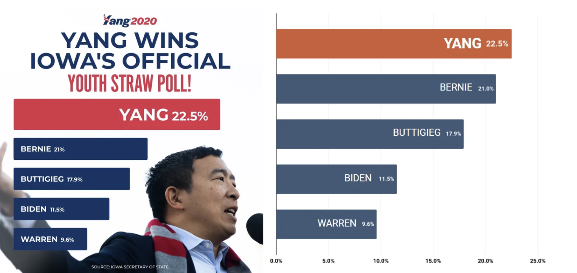
What are Digital Humanities?
Activity 2: Misleading data visualisations
(Ellyatt, 2022)
Notes:
Answer: Whilst Yang did win from his competition, the left graphic makes it seems as though he won by a large margin. Instead the difference between him and Bernie was only 1.5%.

Slide 15
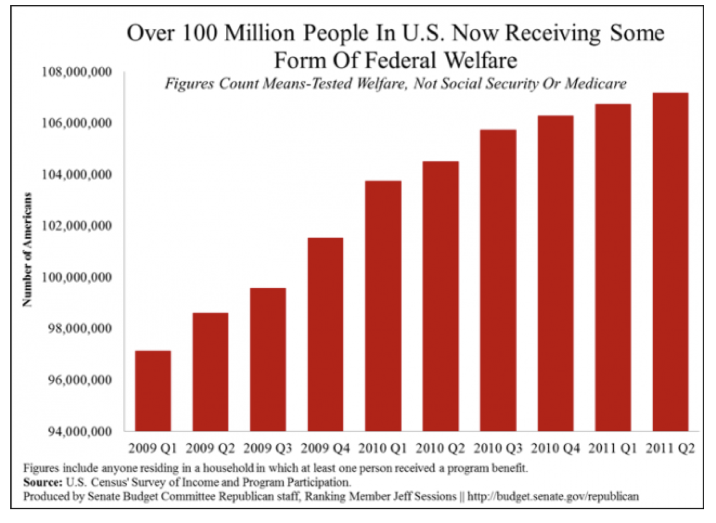
What are Digital Humanities?
(Misleading Graphs: Real Life Examples, n.d.)
Notes:
Answer: Whilst the number of people receiving some form of federal fair did increase between 2009 and 2011, the graphic leaves the impression that this was a high rise in numbers. However, when looking at the start value of the Y axis it can be seen that it starts of 94,000,000.
The actual percentage increase between 2009 and 2011 was: (107,000,000 - 97,000,000) / 97,000,000 x 100% = 10.31%.

Slide 16
What are Digital Humanities?
Examples of computational methods and broader fields (Library Universiteit Leiden, n.d. ; University of Groningen, n.d.; the Computational Linguistics & Text Mining Lab, n.d.) :
Text mining and Natural Language Processing
Text encoding and Enrichment
Human Language Technology
Artificial Intelligence and Large Language Models
Computational Linguistics
Computational Stylistics

Slide 17
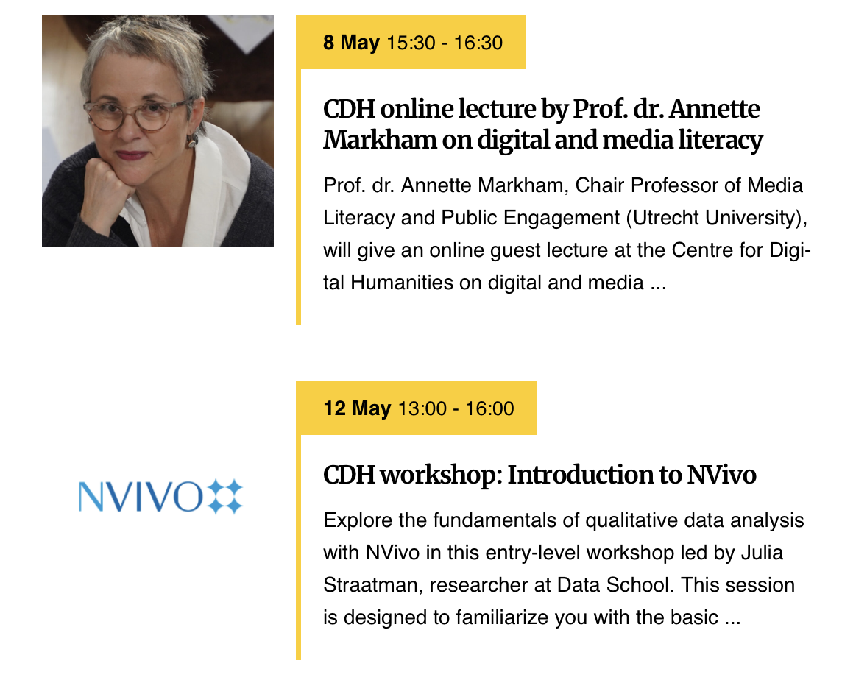
What are Digital Humanities?
Upcoming Lectures and Workshops:
UCR Data Centre:
Office hours and email
Tutorials and Workshops on R and Gen AI
Apprenticeship
Clariah: (In Progress) DH Research Infrastructure
UU Centre for Digital humanities:
Weekly Walk-in hours, and email
Training Programme
Workshops and Lectures
Notes:
This slide is to provide student with support and potential resources to reach out to in case they ever have to work with digital data or computational methods in their courses, assignments, projects.

Slide 18
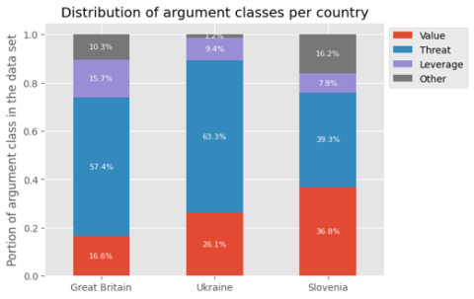
Case studies
CLARIN: “research infrastructure for language as social and cultural data” (n.d.-a)
Parlamint: Corpus containing more than 1 billion words sampled from 29 European countries and autonomeous regions during parliamentary debates (CLARIN, n.d.-a)
Case Study: Echoes of the Chambers: Studying Democracy through Parliamentary Speeches. (Vaibhav Agarwal et al., 2024)
(Vaibhav Agarwal et al., 2024)

Slide 19
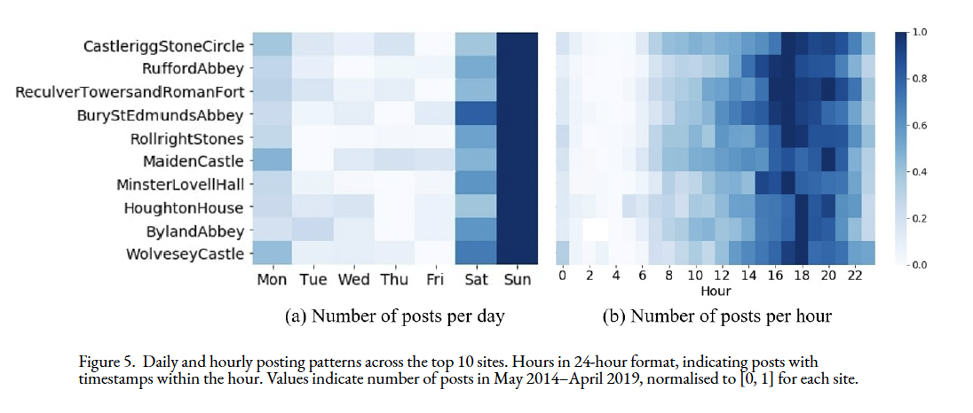
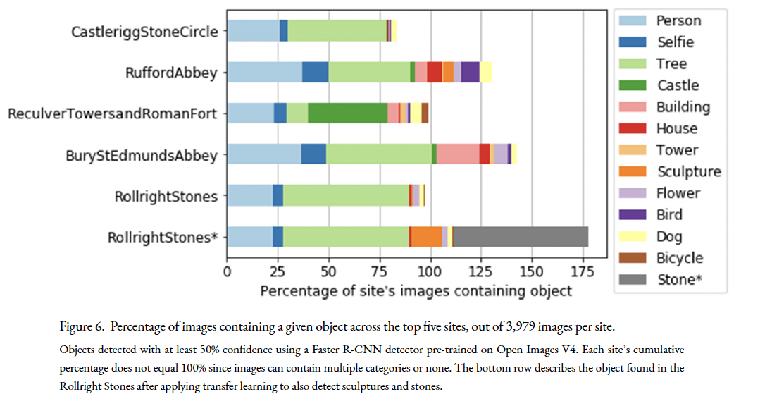
Case studies
Journal of Cultural Analytics: Combining computer science with humanities and social sciences
Case Study: Heritage site-seeing through the visitor’s lens on Instagram (Loke et al., 2022)
(Loke et al., 2022, p.14)

Slide 20
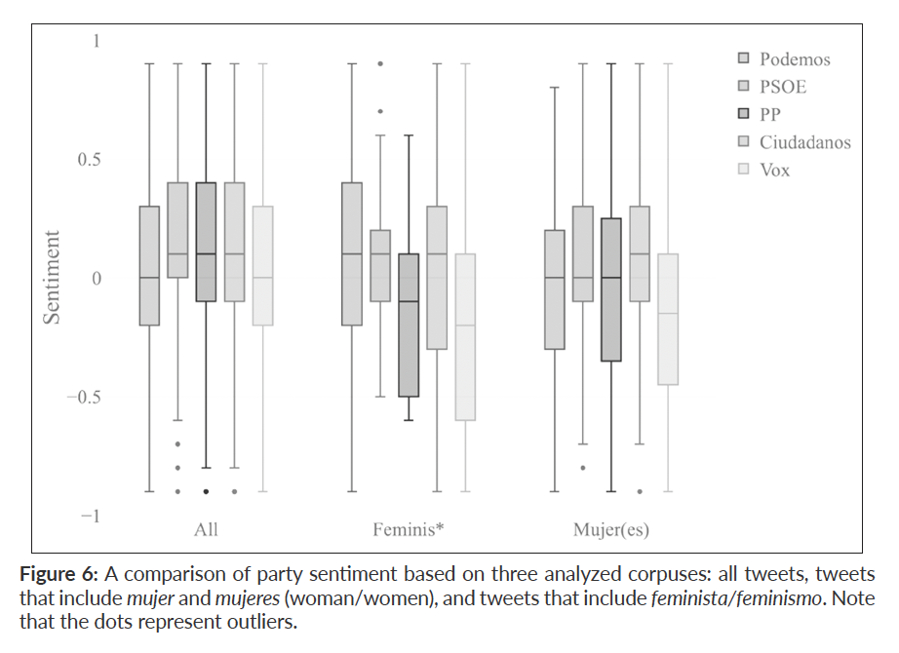
Case studies
Journal of Digital Studies / Le champ numérique:
Serves as an Open Access area and resource for Digital Humanities researchers
Case Study: Style and Rhetoric of Spanish Politics on Twitter (Ceia et al., 2022).
(Ceia et al., 2022, p. 21).

Slide 21
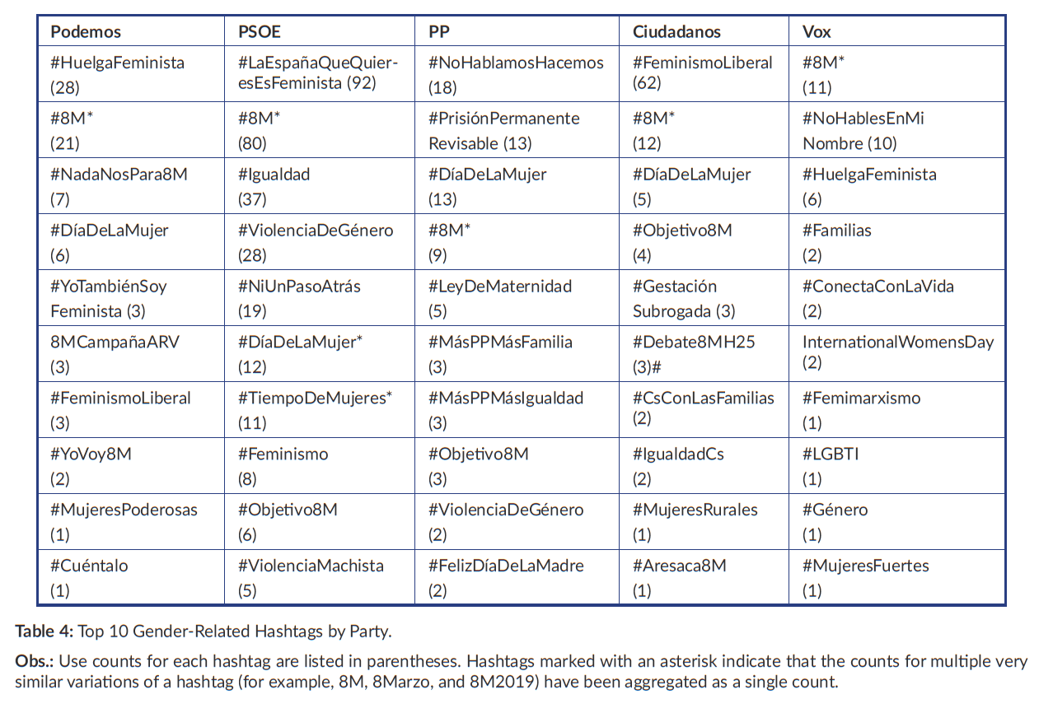
Case studies
(Ceia et al., 2022, p. 23).

Slide 22
Masters
MA Digital Humanities at Rijksuniversiteit Groningen
MA Digital Humantities at Lancaster Universtiy
MA Text Mining at Vrije Universiteit of Amsterdam
Research MA Linguistics: Human Language Technology at Vrije Universiteit of Amsterdam
(Research) MA Media Studies: New Media & Digital Culture at Utrecht Universiteit or University of Amsterdam
MA Media Studies: Digital Cultures at Maastricht University
MA Data Science and Society at University of Edinburgh
For more inspiration: Check suggestions provided by Maastricht University

Slide 23
Discussion on Ethics
So far, we’ve seen that Digital Humanities like using digital data that is publicly available:
CLARIN, Parlamint Corpus
Tourist’s Instagram posts
Politician tweets
Activity 3: In groups of 3-4, discuss and write down whether you consider sampling social media posts from users to be ethical. Does it make a difference if there are public figures such as celebrities or politicians? How would you feel if your social media posts are included in scientific research?

Slide 24
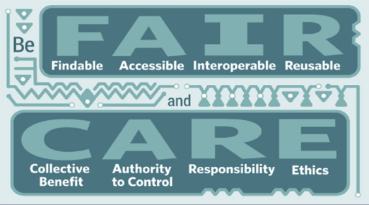
Discussion on Ethics
In general, CLARIN encourages researchers to strive for the following (n.d.-b):
Discussion: What do you think each of these terms is important to aim for?
(Global Indigenous Data Alliance, 2023)

Slide 25
Discussion on Ethics
Lastly, when sampling data consider whether (UU Research Data Management Support):
1. The data is private sensitive
2. The data holds copyright or other intellectual rights
3. The terms of use as listed by the data bank, archive, repository etc.
4. When using secondary research data: are the points above addressed? How was the data sampled? Does it adhere to the FAIR guidelines?

Slide 26
Installing R and RStudio
In a week we will start working with R and RStudio, which you will have to install on your device.
Please go to the Tutorials listed on the UCR Data Center:
https://ucrdatacenter.github.io/tutorials/
Complete the following two tutorials:
Installing R
Getting started with R and RStudio

Slide 27
Next class
Introduction to Language Resources, in particularly Corpora
Introduction to Sketch Engine and investigating Politician’s Tweets
To do: Complete Homework 02
Write in Logbook
Digital Humanities Journal task
Setting up Sketch Engine

Slide 28
References
Agarwal, V., Bonin, H., Ferragallo-Hawkins, K., Fürst, M., Glazacheva, E., Marjanen, J., Milošev,
M., Nevala, E., Oetken, N., Puonti, T., Rousu, O., Turunen, R., Voit-Antal, A., & Wahlsten, J. (n.d.). Echoes of the chambers: Studying democracy through parliamentary speeches. Helsinki Digital Humanities Hackathon 2024. https://drive.google.com/file/d/1CWUBCZKACNfWKnGgZwvtbV1MLGqM-ZV8/view
Berry, D. M. (2019, February 13). What are the digital humanities? The British Academy.
https://www.thebritishacademy.ac.uk/blog/what-are-digital-humanities/
Board of Studies. (2025, February 6). Framework for the use of Gen AI in Spring 2025 at UCR.
University College Roosevelt. https://intranet.ucr.nl/document/studying/rules-procedures/large-language-model-use/2025, from https://www.uu.nl/en/research/research-data-management/guides/policies-codes-of-conduct-and-laws

Slide 29
References
Ceia, V., Mota, T., & Lewis, R. (2022). Style and rhetoric of Spanish politics on Twitter.
Digital Studies / Le Champ Numérique, 12(1). https://doi.org/10.16995/dscn.8097
CLARIN. (n.d.-a). ParlaMint: Comparable and interoperable parliamentary corpora.
Retrieved 13 February 2025, from https://www.clarin.eu/parlamint
CLARIN. (n.d.-b). Tutorial: Intro to CLARIN. Retrieved 14 February 2025, from
https://www.clarin.eu/content/tutorial-intro-clarin#unit-3-sharing-and-archiving-language-resources
Ellyatt, T. (2022, July 22). Poor Data Visualisations, Real Life Examples Out There in the
Wild | Medium. Medium. https://medium.com/@thomas.ellyatt/bad-data-visualisation-real-life-examples-out-there-in-the-wild-eb5032329aeb

Slide 30
References
Global Indigenous Data Alliance. (2023, January 23). CARE Principles.
https://www.gida-global.org/care
Leiden University. (2025, February 14). Centre for Digital Humanities.
https://www.universiteitleiden.nl/en/humanities/centre-for-digital-humanities
Library Universiteit Leiden. (n.d.). Introduction to Digital Humanities.
https://www.library.universiteitleiden.nl/subject-guides/introduction-to-digital-humanities
Loke, T., Teramoto, Y., Camargo, C. Q., & Eccles, K. (2022). Heritage site-seeing
through the visitor’s lens on Instagram. Journal of Cultural Analytics, 7(3). https://doi.org/10.22148/001c.38966

Slide 31
References
Maastricht University. (n.d.). Your future: Digital society. Retrieved 13 February 2025,
from https://curriculum.maastrichtuniversity.nl/education/bachelor/bachelor-digital-society/your-future?_gl=1*wpf6j3*_up*MQ..*_ga*MTU3Mzc0NTU4MS4xNzM5NDc1MTU2*_ga_VJNF5GS2RK*MTczOTQ3NTE1NS4xLjAuMTczOTQ3NTE1NS4wLjAuMA..
Misleading Graphs: Real Life Examples. (n.d.). Statistics How To. Retrieved 14 February
2025, from https://www.statisticshowto.com/probability-and-statistics/descriptive-statistics/misleading-graphs/
Mmeje, C. (2024, November 11). How to Use Search Operators for Advanced Google
Search. Moz. https://moz.com/learn/seo/search-operators

Slide 32
References
The Computational Linguistics & Text Mining Lab. (n.d.). Home. Retrieved 14
February 2025, from http://www.cltl.nl/
University of Groningen. (2019, January 15). Centre for Digital Humanities.
https://www.rug.nl/research/research-let/expertisecentra/centre-for-digital-humanities/
UU Digital Centre for Humanities. (n.d.). Support students. Retrieved 13 February
2025, from https://cdh.uu.nl/support/students/
UU Research Data Management Support. (n.d.). Policies, codes of conduct and laws.
Retrieved 14 February 2025, from https://www.uu.nl/en/research/research-data-management/guides/policies-codes-of-conduct-and-laws

